Slide 1
WP1 Open Mission Platform
EUROCITIES, LGI
UTMC WP1 monthly meeting every first Wednesday on utmc.app requirements
  1. NOV23
  6. DEC23
!D1.3 Platform operations manual EUROCITIES M12/NOV23!
!D1.2 UTMC Platform LGI M15/FEB23!

Slide 2
WP2 F&F
C40/GCoM and ICLEI WS
TAP Transformative Actions Program online marketplace on 22 November 2023
Suggestion: WP2/3 Working Group Meeting with C40/GCoM, ICLEI WS, ENoLL, and FFG
in (23-30) NOV23
including Task 3.2 Global Advocacy

Slide 3
WP3 Global Exchange
ICLEI EUROPE
Task 3.4 Practical city-to-city knowledge exchange on climate neutrality and net-zero pathway implementation (Lead: ICLEI EURO, Contributors: ICLEI WS, Eurocities, ENoLL, C40/GCoM) M3-M36
First Practical P2P Knowledge Exchange on 19 October 2023 (10-11 am, 4-5 pm) highlighting Mannheim city
Suggestion: Task 3.5 Taskforce for Capacity building and mobilisation of urban stakeholders towards climate neutrality FFG, ENoLL, ICLEI EUROPE
Suggestion: Brainstorming/discussion on other spaces/meetings to rethink the focus of the project: refocus/reshape/reprioritization?!

Slide 4
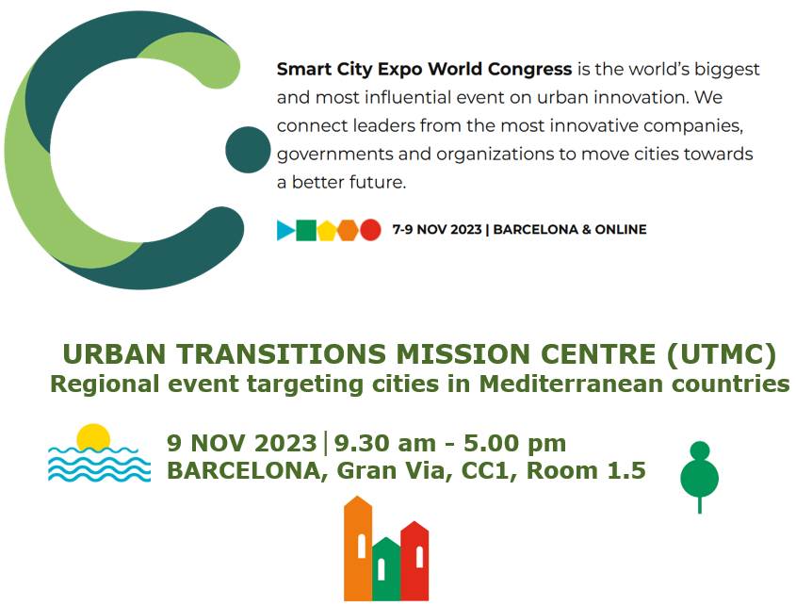
WP4 Visibility
ENoLL, FFG
https://utmc.app/event-74

Slide 5
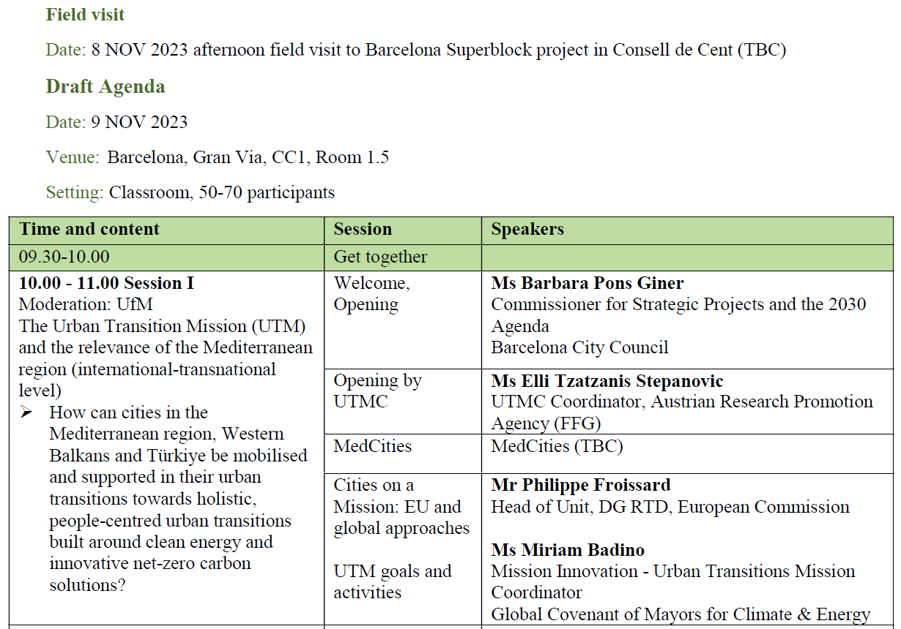
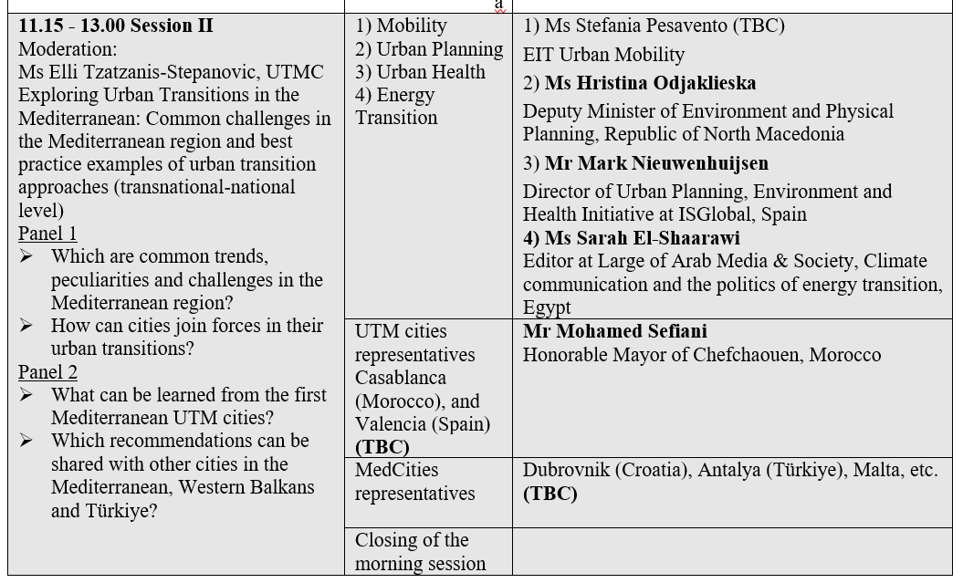

Slide 6
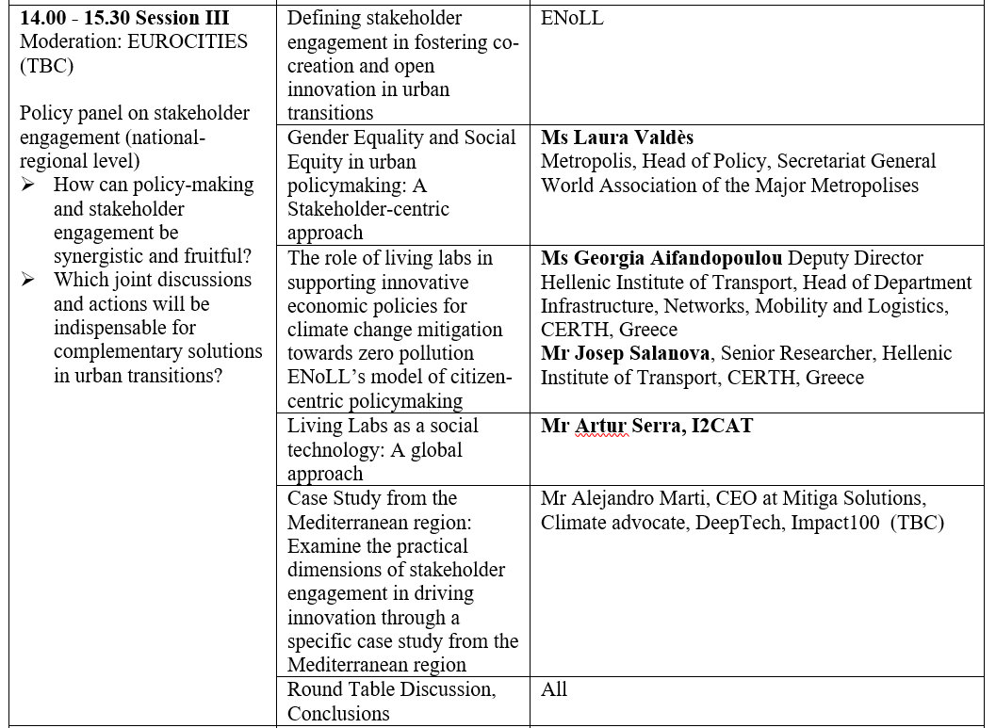
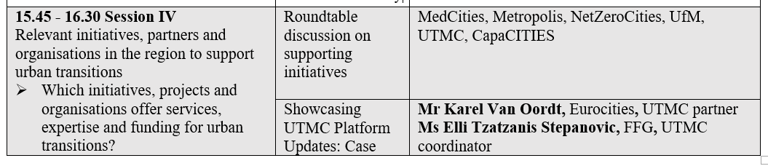

Slide 7
WP5 PM
FFG
Task 5.3 Internal communication
Physical meeting (1,5 days) in JAN24 in BRX (FFG shared premises TBC)
A:16-17.01 Elli, FFG;
B:23-24.01 Karel, Eurocities; Elli, FFG;
C:25-26.01 Karel, Eurocities; Elli, FFG;
Suggestion: interactive WP working groups
First day: WP1-4: 1,5 hours each interactive (09-12, 13-16)
Second day incl. EC: WP1-4 wrap-up and WP5 (9-12)
!Informal technical and financial reporting M1/DEC22-M12/NOV23! Template to be sent!

